Slide 1
Nov. 6th 2017
The 35th IEEE ICCD@Boston, USA
Exploring Scalable Data Allocation
and Parallel Computing on NoC-based Embedded Many Cores
Yuya Maruyama
Graduate School of
Engineering Science
Osaka University
Shinpei Kato
Graduate School of
Information Science and
Technology
The University of Tokyo
Takuya Azumi
Graduate School of
Engineering Science
Osaka University
Notes:
Today, I am going to talk about our work titled “Exploring Scalable Data Allocation and Parallel Computing on NoC-based Embedded Many Cores”.

Slide 2
Necessity and Importance of Embedded Many Cores
[Introduction]
In embedded systems, high processing demand and low power consumption are needed.
Ex. self-driving system
self-driving system
Application
Recognition
Decision
Actuate
Control
Runtime
ROS
CUDA
OpenCV
PCL
AUTOSAR
OS
Real-time Linux
RTOS
Hardware
Many
cores
GPU
Camera
LiDAR
CAN
ECUs
FPGAs
Radar
GNSS
Ether
Notes:
In recent years, embedded systems have become increasingly complicated and diverse.
Self-driving vehicles are one of this complicated and diverse systems.
In many domains, high processing demand and low power consumption are needed.

Slide 3
Necessity/Importance of Embedded Many Cores
[Introduction]
In embedded systems, high processing demand and low power consumption are needed.
Ex. self-driving system
Embedded
Real-time
High performance
self-driving system
Applicatino
認知
判断
操作
制御
Runtime
ROS
CUDA
OpenCV
PCL
AUTOSAR
We need heterogeneous systems.
OS
Real-time Linux
RTOS
Hardware
Many
cores
GPU
Camera
LiDAR
CAN
ECUs
FPGAs
Radar
GNSS
Ether
Notes:
To meet this demands, we need heterogeneous systems such as coexistence of many cores, GPU, and FPGA.
Combining the advantages of each platform, we think that heterogeneous computing can meet embedded and real-time requirements and realize high performance with reasonable power consumption.
In our work, we focus on the many-core computing platforms.

Slide 4
Comparison of many core architecture
[Introduction]
 | Non-Cluster | Cluster
NoC Architecture
Programmability | ✓
Scalability |  | ✓
core
core
core
core
core
core
core
core
core
core
core
core
core
core
core
core
memory
memory
core
core
core
core
core
core
core
core
core
core
core
core
core
core
core
core
memory
memory
memory
Network-on-Chip (NoC)
Notes:
Subsequently, we compare two types of many-core Network-on-Chip architecture.
One is Non-Cluster architectures, and the other is Cluster Architecture.
In the former, all cores share large memories with large bandwidth.
In contrast, in Cluster architectures, several cores gather to form a cluster and distributed memories are connected to the network on chip.
In our work, we explore latter cluster architectures for scalability.

Slide 5
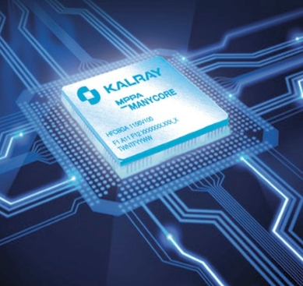
KALRAY MPPA-256
[System Model]
NoC-based Embedded Many Cores: MPPA-256
Scalability: 256 + 16 cores
High power efficiency: 16/24W
NoC (Network-on-Chip)
non-uniform memory access (NUMA)
Compute Cluster
16 computing cores per cluster
shared memory (SRAM 2MB) per cluster
NoC interface
16 x 16 = 256
I/O Cluster
4 IO cores per cluster
shared memory (SRAM 2MB + DDR 2GB)
NoC interface
Ethernet, PCIe
Notes:
We adopt KALRAY MPPA as Network-on-chip-based embedded many core platform.
This has more than 256 cores on NoC and high power efficiency for embedded computing.
A cluster of 16 cores called Compute Cluster shared 2 MB SRAM memory.
These memories of 16 clusters are connected to NoC.
For I/O, a cluster of 4 cores called IO Cluster contains 2 MB SRAM and 2 GB DDR memories.

Slide 6
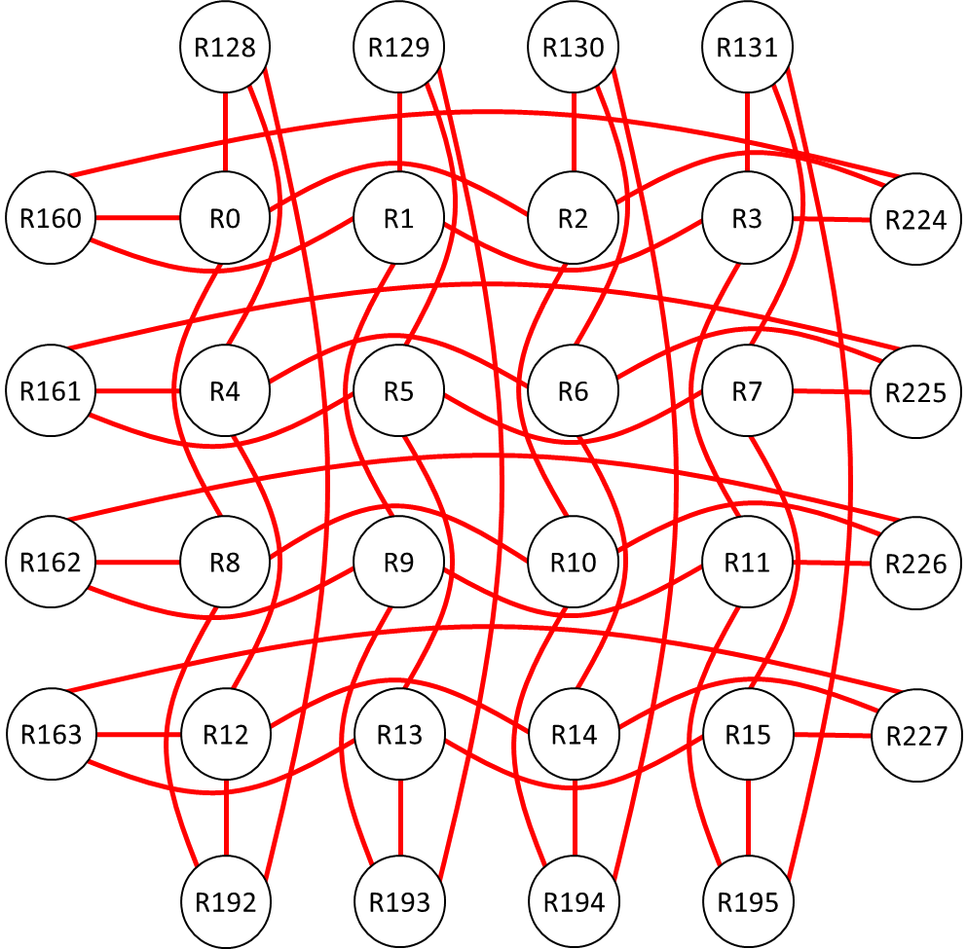
KALRAY MPPA-256
[System Model]
NoC-based Embedded Many Cores: MPPA-256
Scalability: 256 + 16 cores
High power efficiency: 16/24W
NoC (Network-on-Chip)
non-uniform memory access (NUMA)
Compute Cluster
16 computing cores per cluster
shared memory (SRAM 2MB) per cluster
NoC interface
I/O Cluster
4 IO cores per cluster
shared memory (SRAM 2MB + DDR 2GB)
NoC interface
Ethernet, PCIe
Notes:
Actual network on chip is like this.
Distributed memories on NoC realize high scalability of the number of cores.

Slide 7
Two evaluations on NoC-based Embedded Many Cores
[Contribution]
[NoC Data Transfer]
The evaluations of the data transfer on DMA-capable NoC quantitatively characterize the end-to-end latencies, which depend on the routing, DMA configurations, and memory type.
[Practical Application]
The scalability of parallelization in many-core processors based on NoC is observed in a real complex application as a part of a self-driving driving system.
Notes:
This is a brief summary of our work.
We provide two contributions on NoC-based embedded many-core platform.
One is the evaluation of NoC data transfer between memories.
The other is parallelization of practiceal application on MPPA.
In this talk, we focus on the latter part.

Slide 8
Two evaluations on NoC-based Embedded Many Cores
[Contribution]
[NoC Data Transfer]
The evaluations of the data transfer on DMA-capable NoC quantitatively characterize the end-to-end latencies, which depend on the routing, DMA configurations, and memory type.
Self-driving application on Real-time OS on Embedded Many Cores
Evaluation
Parallelization
Simulation
Test course
[Practical Application]
The scalability of parallelization in many-core processors based on NoC is observed in a real complex application as a part of a self-driving driving system.
Notes:
We port and parallelize a part of self-driving application on real-time Operating System on embedded many cores.

Slide 9

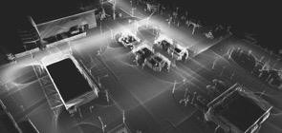

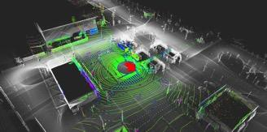
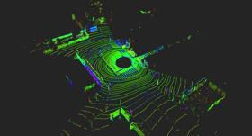
Self-driving/Localization
[Practical Application]
NDT Matching Algorithm
Estimate current position by matching 3D map data and 3D laser scan
3D map data
NDT matching
Current position
- PCL (open source Point Cloud Library)
- LIDAR (Laser Imaging Detection and Ranging)
- SLAM (Simultaneous Localization And Mapping)
- NDT (Normal Distributions Transform)
3D laser scan
Notes:
We parallelize localization algorithm of self-driving application because it is important and requires high processing demand in self-driving systems.
This algorithm estimates a current position on the map by matching the 3D map data and 3D laser scan.

Slide 10
Self-driving/Localization/Parallelization
[Practical Application]
TODO
Deadline
100 ms
Parallelize part of the bottleneck
Notes:
Here is a pie chart showing the bottleneck part of the algorithm.
As you can see in this chart, two parts occupy almost 90%.
Light blue part corresponds to a nearest neighbor search.
Blue part corresponds to a computation of evaluation function by derivatives for convergence of newton method.
We parallelize the latter part and accelerate execution time from 300 ms to 80 ms in the right graph.
In many self-driving systems, laser sensors get data with 10 Hz, so that deadline can be assumed with 100 ms.

Slide 11
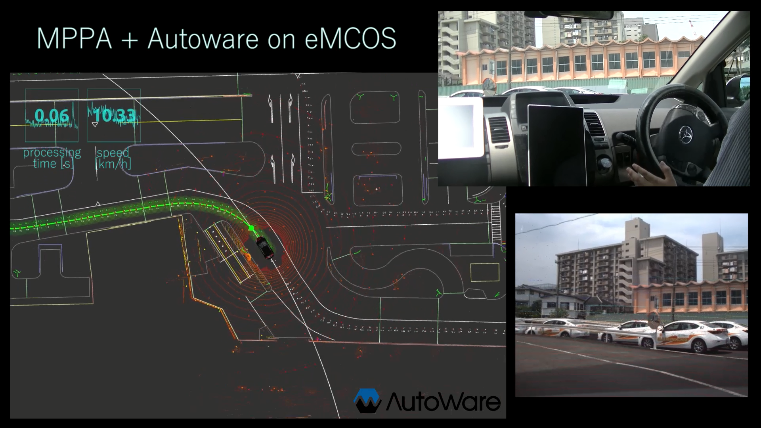

Self-driving/Localization/Parallelization/Video
[Practical Application]
powered by
Notes:
This is demonstration video in our test course.
We plug MPPA and lap top computer to network in the car.
Steering, accelerator, and brake are automatically controlled based on the result of MPPA.
(Algorithms except for localization runs on the lap top computer and we use Autoware, which is open-source software for urban autonomous driving. Upper left values are MPPA processing time with seconds and car speed with km/h.)

Slide 12
Summary and Future Work
[Conclusion]
[NoC Data Transfer]
Analyze end-to-end latencies, which depend on the routing, DMA configurations, and memory type
[Practical Application]
Confirm the scalability of parallelization in a real complex application
[Future Work]
Parallelize remains of self-driving localization and other algorithms
Run benchmark applications such as Rodinia for furthermore analysis
Notes:
In our work, we provide two contributions as shown in the slide.
This is a very early stage of the self-driving application on the embedded many-core platform.
In future work, we have to parallelize remains of self-driving localization and other algorithms. In addition, we would like to run benchmark applications such as Rodinia for furthermore analysis.

Slide 13
Software Stack
[Practical Application]
Application
Localization algorithm of self-driving application
Runtime
LibNoC
PCL
ROS
OS
Real-Time OS (eMCOS)
MPPA
Cluster
CC1
CC2
CC16
IO
…
Memory
SMEM
SMEM
SMEM
SMEM
DDR
…
Network
NoC
Ether
Notes:
This is software stack for self-driving application on many cores.
Based on MPPA, we adopt eMCOS which is a real-time operating system provided by a Japanese supplier, eSOL.
It is hard to run existing other operating systems because cores of MPPA does not guarantee cache coherency and require high parallelism.
We build application on several runtime middleware and libraries.
ROS means Robot Operating System which is not OS but runtime library and tool for robot operating.
PCL means Point Cloud library which handles point cloud scanned by laser sensor on a car.
I will explain brief algorithm of localization algorithm of self-driving application and PCL in the next slide.

Slide 14
KALRAY MPPA-256
[System Model]
NoC-based Embedded Many Cores: MPPA-256
Scalability: 256 + 16 cores
High power efficiency: 16/24W
NoC (Network-on-Chip)
non-uniform memory access (NUMA)
Compute Cluster
16 computing cores per cluster
shared memory (SRAM 2MB) per cluster
NoC interface
16 x 16 = 256
I/O Cluster
4 IO cores per cluster
shared memory (SRAM 2MB + DDR 2GB)
NoC interface
Ethernet, PCIe
Notes:
We adopt KALRAY MPPA as Network-on-chip-based embedded many core platform.
This has more than 256 cores on NoC and high power efficiency for embedded computing.
A cluster of 16 cores called Compute Cluster shared 2 MB SRAM memory.
These memories of 16 clusters are connected to NoC.
For I/O, a cluster of 4 cores called IO Cluster contains 2 MB SRAM and 2 GB DDR memories.

Slide 15
KALRAY MPPA-256
[System Model]
NoC-based Embedded Many Cores: MPPA-256
Scalability: 256 + 16 cores
High power efficiency: 16/24W
NoC (Network-on-Chip)
non-uniform memory access (NUMA)
DDR
Compute Cluster
16 computing cores per cluster
shared memory (SRAM 2MB) per cluster
NoC interface
Ether
Ether
I/O Cluster
4 IO cores per cluster
shared memory (SRAM 2MB + DDR 2GB)
NoC interface
Ethernet, PCIe
DDR
Notes:
For I/O, a cluster of 4 cores called IO Cluster contains 2 MB SRAM and 2 GB DDR memories.
They also connected to NoC.

Slide 16
KALRAY MPPA-256
[System Model]
NoC-based Embedded Many Cores: MPPA-256
Scalability: 256 + 16 cores
High power efficiency: 16/24W
NoC (Network-on-Chip)
non-uniform memory access (NUMA)
Compute Cluster
16 computing cores per cluster
shared memory (SRAM 2MB) per cluster
NoC interface
I/O Cluster
4 IO cores per cluster
shared memory (SRAM 2MB + DDR 2GB)
NoC interface
Ethernet, PCIe
Notes:
Actual network on chip is like this.
Distributed memories on NoC realize high scalability of the number of cores.

Slide 17
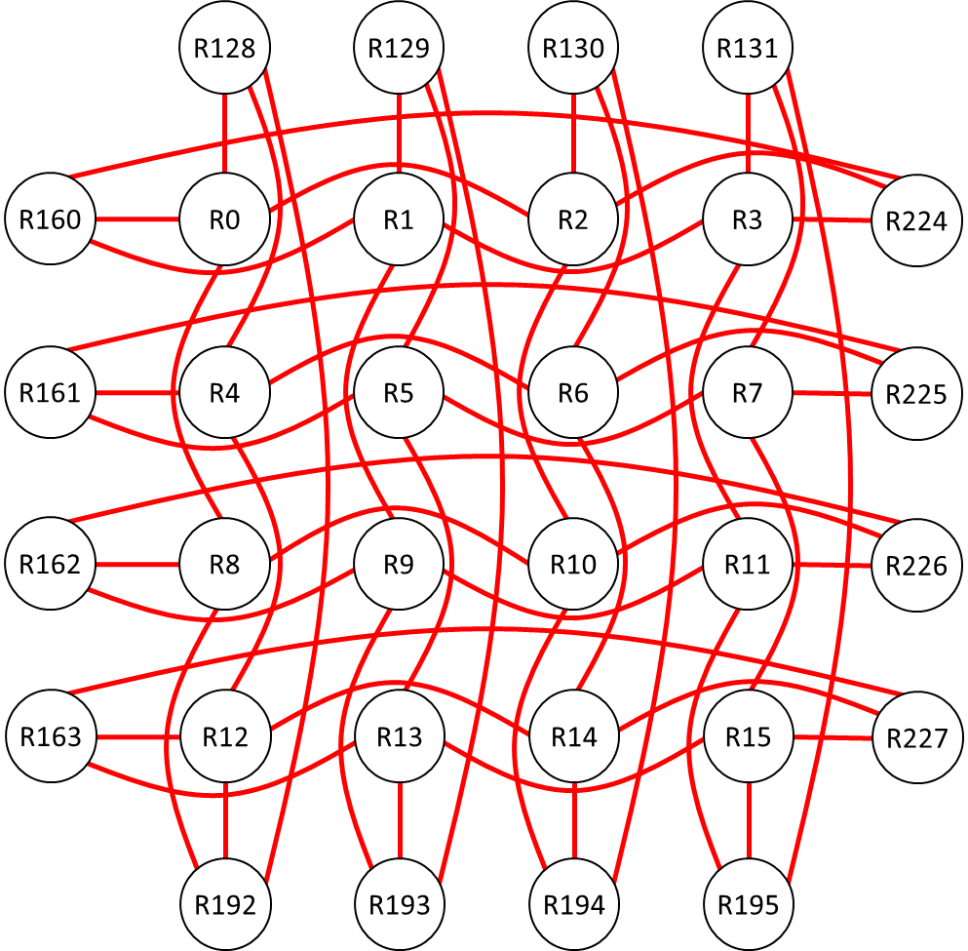
KALRAY MPPA-256
[System Model]
NoC-based Embedded Many Cores: MPPA-256
Core layer
Memory layer
Network layer
Core
Memory
Network
4
2M + 2G
16
16
16
16
2M
2M
2M
2M
16
16
16
16
2M
2M
2M
2M
4
4
2M
2M
16
16
16
16
2M
2M
2M
2M
16
16
16
16
2M
2M
2M
2M
4
2M + 2G
Notes:
We adopt KALRAY MPPA as Network-on-chip-based embedded many core platform.
This has more than 256 cores on NoC and high power efficiency for embedded computing.
A cluster of 16 cores called Compute Cluster shared 2 MB SRAM memory.
These memories of 16 clusters are connected to NoC.
For I/O, a cluster of 4 cores called IO Cluster contains 2 MB SRAM and 2 GB DDR memories.

Slide 18
Comparison of many core architecture
[Introduction]
 | Non-Clusters | Clusters
Architecture
Reusability | ○ | △
Scalability | △ | ○
Power Efficiency | △ | ○
core
core
core
core
…
core
core
core
core
…
…
…
…
…
…
…
…
memory
Bus
memory
core
core
core
core
…
Network-on-Chip (NoC)
memory
Notes:
So far, I have talked about necessity and importance of embedded many-core platforms.
Secondly, we compare two type of many-core architecture.
One is Uniform Memory Access, and the other is Non-Unified Memory Access.
In Uniform Memory Access, all cores share one large memory with large bus.
All cores are connected equally to the memory.
This is the same architecture of single/multi core platform, so that existing software
So that
In contrast, in Non-Uniform Memory Access, core memory

Slide 19
R128
R129
R130
R131
R160
R0
R1
R2
R3
R224
R161
R4
R5
R6
R7
R225
R162
R8
R9
R10
R11
R226
R163
R12
R13
R14
R15
R227
R192
R193
R194
R195

Slide 20
KALRAY MPPA-256
[System Model]
4
2M + 2G
16
16
16
16
2M
2M
2M
2M
16
16
16
16
2M
2M
2M
2M
4
4
2M
2M + 2G
16
16
16
16
2M
2M
2M
2M
16
16
16
16
2M
2M
2M
2M
4
2M + 2G
Notes:
We adopt KALRAY MPPA as Network-on-chip-based embedded many core platform.
This has more than 256 cores on NoC and high power efficiency for embedded computing.
A cluster of 16 cores called Compute Cluster shared 2 MB SRAM memory.
These memories of 16 clusters are connected to NoC.
For I/O, a cluster of 4 cores called IO Cluster contains 2 MB SRAM and 2 GB DDR memories.

